Slide 1

Sentinels orientation workshop: college 101
Fall 2025
Champlain College-Lennoxville
Ingrid Cardyn
Maude Fortier
Notes:
Introduce ourselves (pronouns, role)
Today’s workshop: Filling your backpack for college

Slide 2
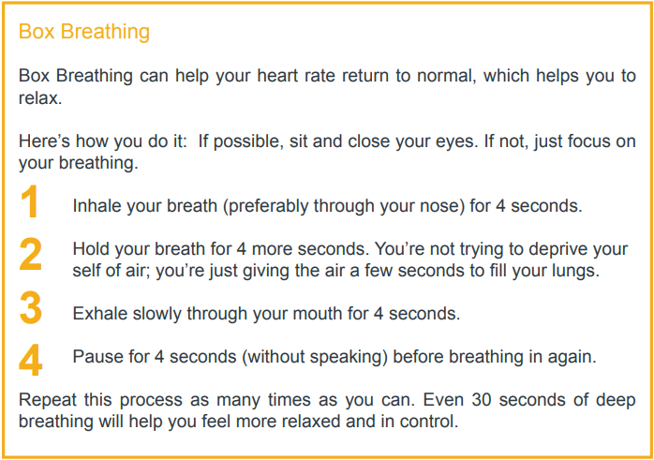
BREATHE
Source: Transitions, p.55
Notes:
(BEST: Breathe)
Explore a few stress management techniques.
= a breathing technique
Use your diaphragm muscle to engage your parasympathetic nervous system (relaxes your body after periods of stress or danger) to overide your sympathetic nervous system (role in responding to dangerous or stressful situations/fight or flight)
You can easily apply this technique in situations where your stress response is intense, and you can do it in a way that no one else will notice.

Slide 3

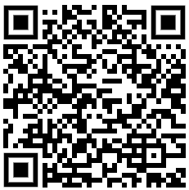
Download your free book:
Table of Contents:
Academics (School, Money)
Health (Mental Health, Mental Illness, Sexual Health)
Personal (Identity, Sexual Orientation & Gender Identity)
Community (Relationships, Living Situation, Life Online)
Getting Help
https://mentalhealthliteracy.org/wp-content/uploads/2019/05/FINAL-Transitions-MAY-2019-Full-Online.pdf
Notes:
I
-Canadian tool based off feedback from a large number of post-secondary students (what they wish they had known when they started their first year of university or college)
-Covers important things that aren’t usually talked about, but that can come up at this transition point in your life.

Slide 4
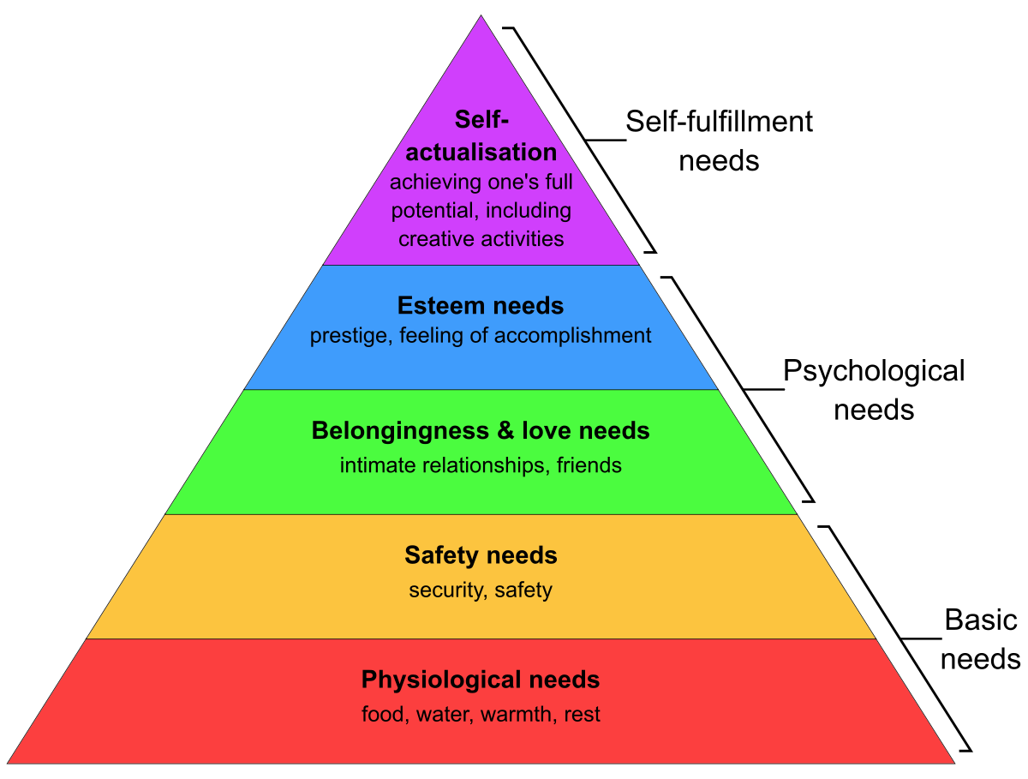
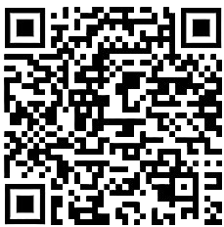
How can you meet your needs as a new college student?
College Living Made Easy
Notes:
M
(BEST: Empathy)
Maslow’s Hieararchy of Needs
What can you do to meet them (and others to help you meet them)?
Erika Boyer's tool College Living Made Easy (SET graduate)=might help them meet some needs during the first weeks

Slide 5
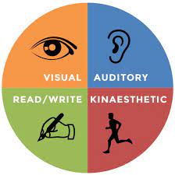
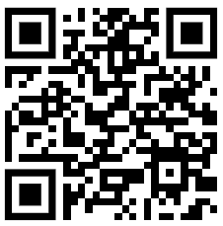
Learning Styles
https://vark-learn.com/the-vark-questionnaire/
Notes:
I
It helps to know which type of learner you are to discover how you learn best.
Can help you identify effective study methods and improve your learning outcomes

Slide 6

Auditory Learners:
Strategies for your predominant Learning style(s)
You tend to learn better when the subject matter is reinforced by sound.
Tips for your learning style:
Be sure to attend class to hear the teacher speak
Listen to narrated PowerPoint presentations, audiobooks and videos
Repeat information out loud to help you remember key points when studying
Discuss your ideas and understanding of the material with fellow-classmates
Participate in group discussions in class
Sources: Transitions, p.19 & 20 https://www.rasmussen.edu/degrees/education/blog/types-of-learning-styles/
Notes:
You may excel at verbally explaining things.

Slide 7

Visual Learners:
You tend to learn through sight and better understand information when it’s presented in a visual way.
Tips for your learning style:
Create diagrams, graphic images and charts of written or verbal explanations, to make the information visually stand out
Highlight key points, use different colours
Doodle in your notebooks to emphasize important information
Use sticky notes to mark off important parts of text in your textbook
Watch instructional videos (e.g. on YouTube)
Use the whiteboards or smartboard
Use written handouts and presentations
Allow for sufficient time to absorb and process the material (visual cues)
Sources: Transitions, p.19 & 20https://www.rasmussen.edu/degrees/education/blog/types-of-learning-styles/
Notes:
Also referred to as spatial learning style
You are partial to seeing and observing visual cues/input

Slide 8


Reading/Writing Learners:
You tend to learn through the written expression, by reading everything you can get your hands on and by writing.
Tips for your learning style:
Get ideas out on paper
Make lists of important information
Write categories and headings
Always take notes – in class or when reading material
After class, elaborate on the information in your notes in your own words, to help you understand the material
Reread material until the information “sticks” and that you are able to recall it and it’s meaning
Transform diagrams into stories (readable format)
Allow for sufficient time to absorb information through the written word
Sources: Transitions, p.19 & 20https://www.rasmussen.edu/degrees/education/blog/types-of-learning-styles/
Notes:
Some overlap with visual learning
The traditional education system caters to this learning style

Slide 9


Tactile Learners:
You tend to learn through experiencing/physically sensing concepts.
Tips for your learning style:
Find ways to try out the technique/concept you’re studying (hands-on) in order to physically sense/experience it
Look for opportunities in your life and in your community to explore in-vivo, the concepts you’re learning
Stay in motion (e.g. Study on the stationary bike, walk around/pacing while preparing your ideas for an assignment or memorizing)
If you can’t move while studying, take breaks regularly to get up and stretch
Trial and error (experimenting) is one of the ways you learn best
Get moving in class when possible (e.g. write on the whiteboard, participate in learning games that involve moving around the classroom)
Sources: Transitions, p.19 & 20https://www.rasmussen.edu/degrees/education/blog/types-of-learning-styles/
Notes:
Also called kinesthetic learning
Often excel at sports

Slide 10






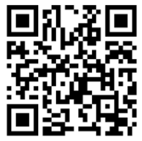
Academic support
Champlain brains
Writing Center
Notes:
M + I Info on learning styles, accomodations, neurodivergence
M
-Writing Center (peer tutors)
-CAF Centre d’aide au Français
Brains: Student peer tutors available to help you with tech knowledge and computer skills
Peer tutors in every program, contact Maude Fortier

Slide 11
Stress
Stress response: how your brain and body let you know you have a challenge or problem that needs to be addressed.
A signal that underlies adaptation and is key for building resilience.
Most stress that we experience daily is actually good for us and avoiding it could be harmful.
The only stress that can really cause us harm is toxic stress (like abuse, neglect, violence and poverty), especially over a prolonged period of time.
Regular everyday stress actually makes us stronger because each time you experience and cope with a stressful situation, you’re making yourself stronger and more resilient to stressors.
You are learning how to better cope with the challenges of life and developing skills that you can use in the future.
The key is not just reducing the amount of stress you experience but learning how best to deal with the stress that comes along with being alive.
Source: Transitions, p.52
Notes:
Tool to read Info about stress (which is normal to experience during your transition to college)
Vs anxiety which is a constant state of hyper-arousal
The next time a similar stressor comes along, you’ll be better equipped to handle it and it likely won’t feel as stressful as it did this time.

Slide 12
strategies for building academic resilience
Be realistic and put things into perspective. Not every stressor is the end of the world, and most are growth promoting. Strategy: Ask yourself if you’ll remember this moment in two years’ time.
Take action when you need to. Instead of feeling helpless, get out there and find solutions.
A positive attitude helps you to see humor in stressful situations.
Accept that the world does not necessarily need to change to accommodate to you. Sometimes you need to change how you are dealing with it. Take ownership.
If something is wrong, speak up. Be polite about it but speak up.
Relationships matter. Having a good support network provides a buffer for stress. Take time to nurture yours.
Trust yourself and trust in your work ethic. Hard work often leads to good results. It’s not how smart you are but how hard you work that usually counts most.
If you need help, seek it out when you first realize that you need help, don’t wait until there is a crisis.
Figure out what you did wrong and learn from it to plan for a better result in the future (what could you have done differently?).
Source: Transitions, p.38 & 39
Notes:
Tool for them to read
Definition: the ability to adapt and achieve good educational outcome despite adversity.
challenges/failure = springboard for self-improvement

Slide 13
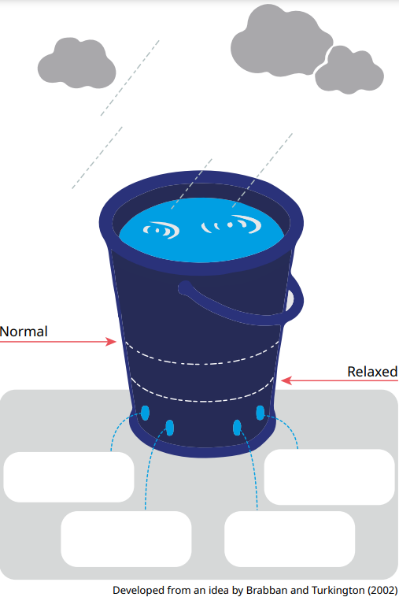
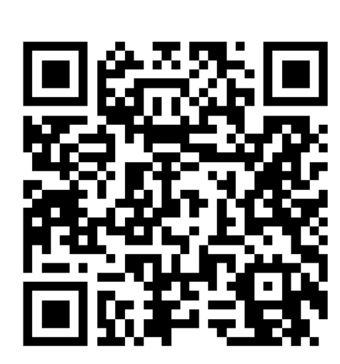
Stress bucket
← your stressors
← your stress level
←self-care strategies
Source: https://s3-eu-west-2.amazonaws.com/mhukcdn/wp-content/uploads/2020/04/16103320/Stress-Bucket-Template.pdf
Notes:
I: Guided reflection
M: animation apparition mots (examples d’élèves)
(BEST: Self-care)
-Clouds = the things that cause you stress, that rain into your bucket and gradually fill it up.
We all have a stress bucket that is unique to us. Vulnerability = size of our bucket.
-Taps =self-care, coping strategies that release stress. e.g. eating well, exercising, hobbies/interests.
Good coping=taps working to evacuate stress Vs Taps not working = water fills bucket and overflows
Activity: To help us become aware of our current stressors, how full our bucket is, and whether we need to work on our taps to manage our stress.
Helps us to rebalance by identifying current stressors in our life and strategies to manage them.
Identify the things that cause you stress (the clouds) and the things you do to manage them (your taps).
-What size and shape is your stress bucket? How full is it? What are the signs that your bucket is getting too full or overflowing? Are all of your taps working? How do you currently relieve stress? Do you turn to unhealthy ways to release stress and what does this look like?
-Self-care strategies are proactive habits that help us evacuate stress
The next slides in your handout are strategies to help manage stress (to read)

Slide 14
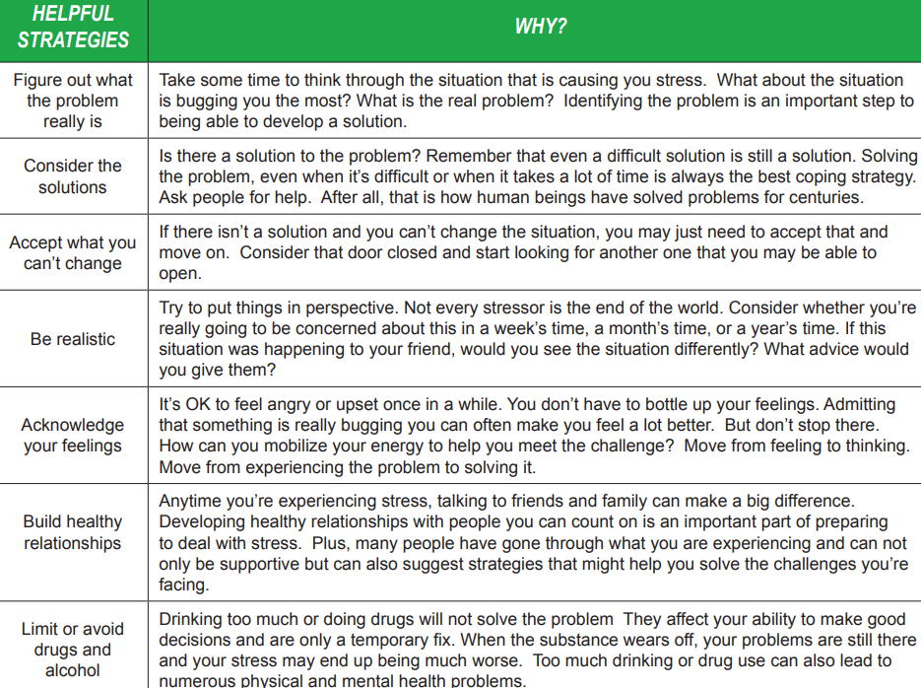
Stress management strategies
Source: Transitions, p.56
Notes:
Check which of these strategies you use to help manage your stress.

Slide 15
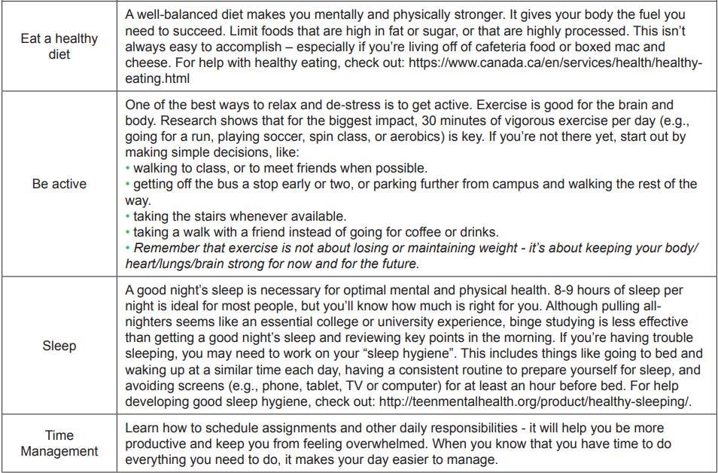
Source: Transitions, p.56
Notes:
Link to needs

Slide 16


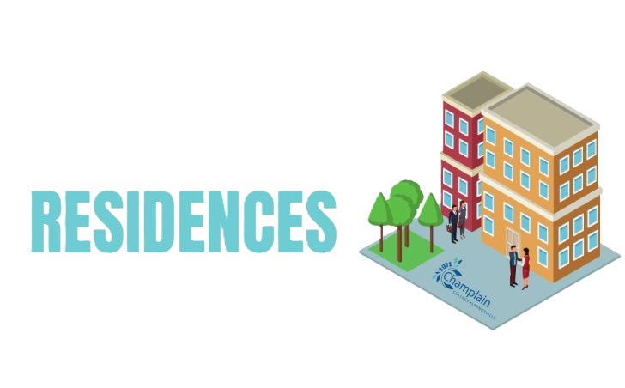
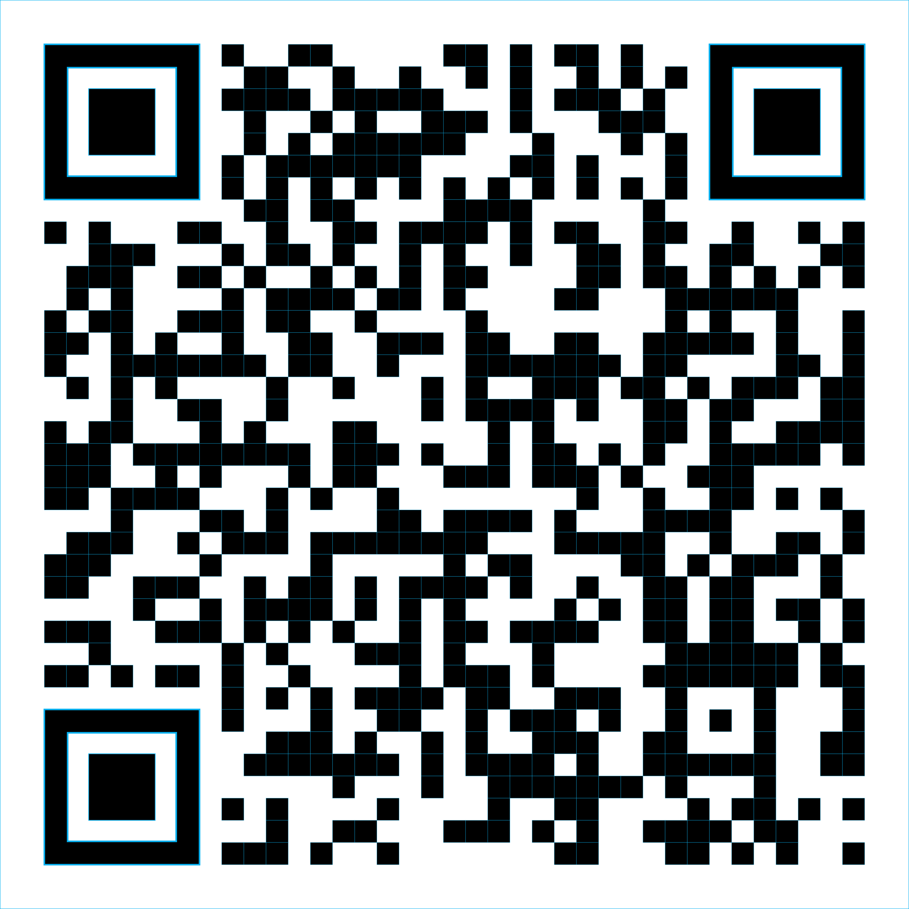

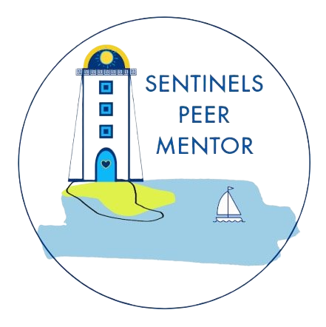

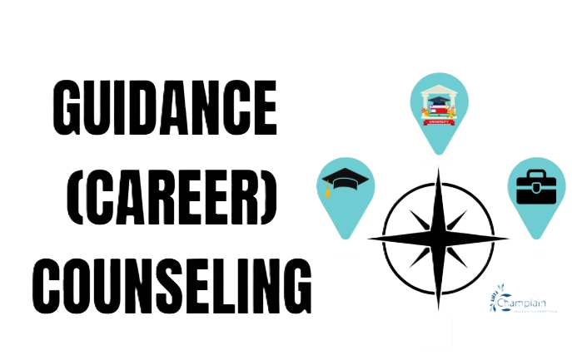
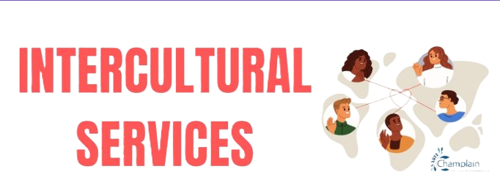
SEXed
Email counsellingserviceslennox@crcmail.net
or
Complete the in-take form on the Champlain website
Contact Ingrid Cardyn
Notes:
M
Freego & Little Forks Food Security Program: • La Grande Table • Referral from counselling services • Healthy frozen meals for a maximum of 7 meals per student per week • Deliveries every Monday • Anonymous program
Have a question? Need to vent? Trying to locate services or support? Ask a Peer Guide!
CSA

