Slide 1
What is Moodle? For Teachers
1. What is Moodle?
2. What can Moodle Do?
3. How can I Integrate Moodle into my Teaching?
Fall 2022
Updated Fall 2023

Slide 2
1. What is Moodle?
Moodle is a Learning Management System (LMS).
Similar to Blackboard, Canvas, or Omnivox, Moodle is simply a platform that allows instructors to manage a class and class activities.
Different from Omnivox, Moodle allows for a wider-range of layout options. It also allows for the integration of online quizzes and other interactive activities.

Slide 3
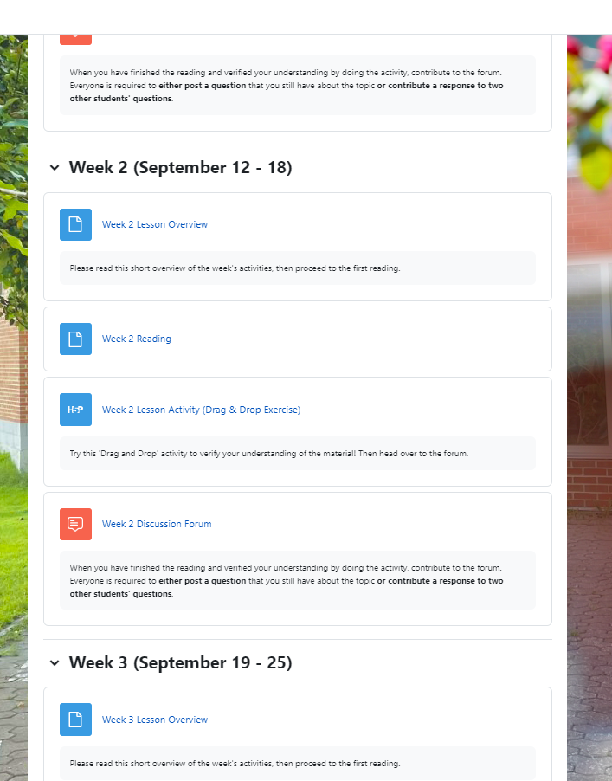
In this setting, the Moodle course is arranged by Weeks or Lessons. (The labels can be customized.)
Each section can be used to guide the student through a series of activities: A reading, an activity, and a forum contribution, etc. As few or many items as the teacher likes can be included.
Alternatively, the course page can also be organized by topics or other criteria.

Slide 4
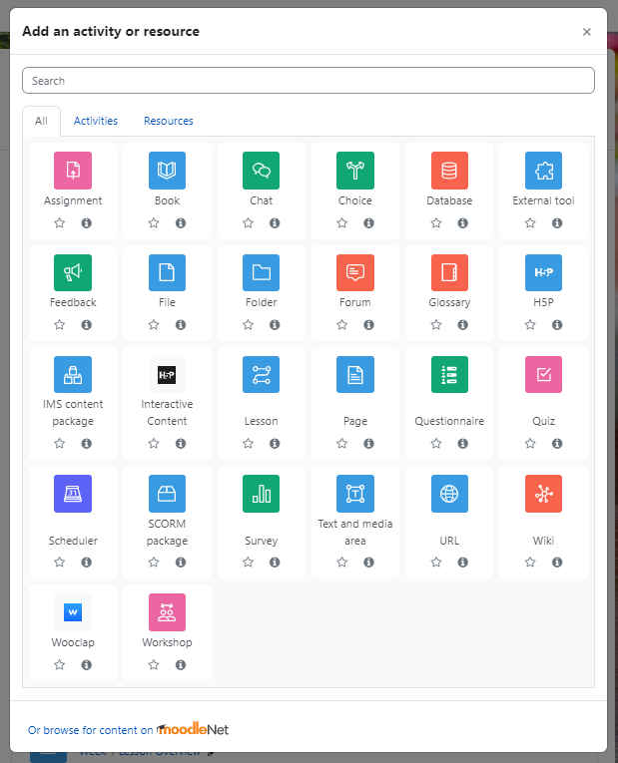
Many of the features available in Moodle are also available in various forms in Omnivox:
You can maintain a gradebook, add assignment drop boxes, post documents and links, and host a forum.
The advantage of Moodle is its adaptable layout and the availability of integrated quizzes and various learning activities.

Slide 5
2. What Can Moodle Do?
Moodle has tools to create:
Surveys for student feedback;
Interactive glossaries of class terms to which students can contribute;
Quizzes with many kinds of question formats;
Drag and Drop exercises for studying terms and other content;
Listening and speaking exercises;
Interactive Videos.

Slide 6
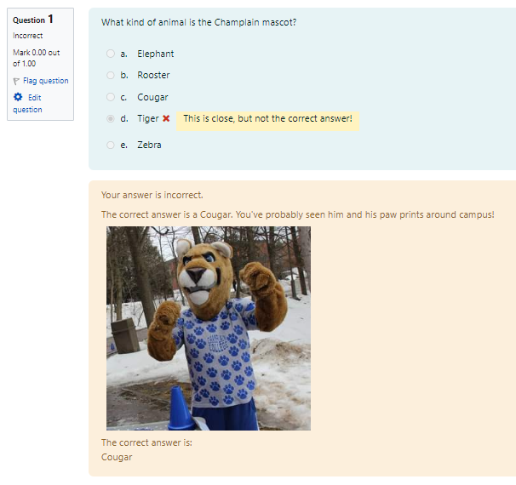
Interactive Quizzes
Traditional quizzes can be set up with multiple choice, fill in the blank, and matching questions, all of which can be set to be automatically graded. Manually-graded written response questions can also be included. (In fact, there is a way to create automatically graded long-answer questions for certain situations!)
The instructor can customize several quiz parameters: Quizzes can be graded in various ways or not graded; students can be allowed to write quizzes once or many times; the points-value of each question can be adjusted independently; etc.
Individual response feedback can also be customized and automated.

Slide 7
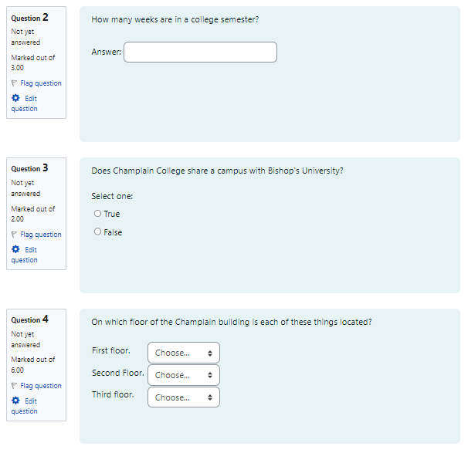
Numerical, True and False, and Matching questions can all be created in Moodle quizzes.

Slide 8
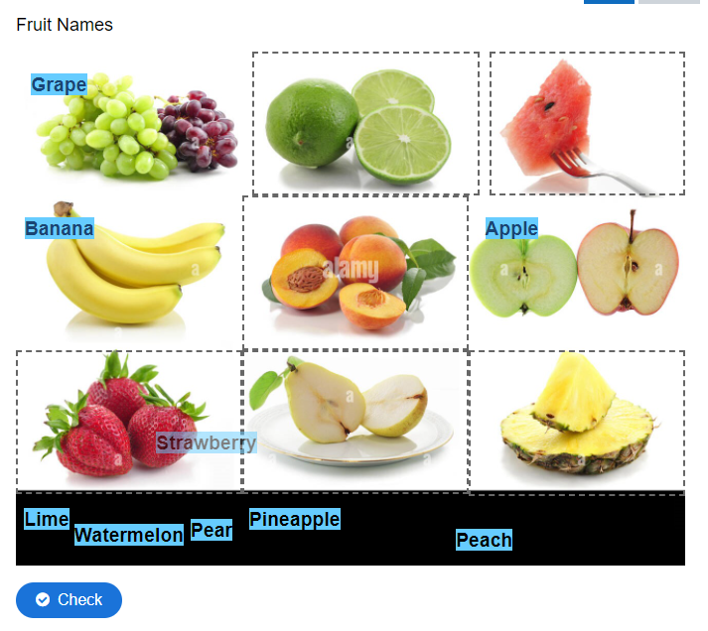
Diverse Activities
Through an integrated tool called H5P, instructors can create many kinds of activities. Drag and Drop and other small exercises are a great way to help students test their vocabulary or comprehension of other concepts.
Using any background photo, you can set up word or picture icons that have to be dragged to the appropriate locations.
This could be for language students or for other disciplines that require extensive learning of new terminology.

Slide 9
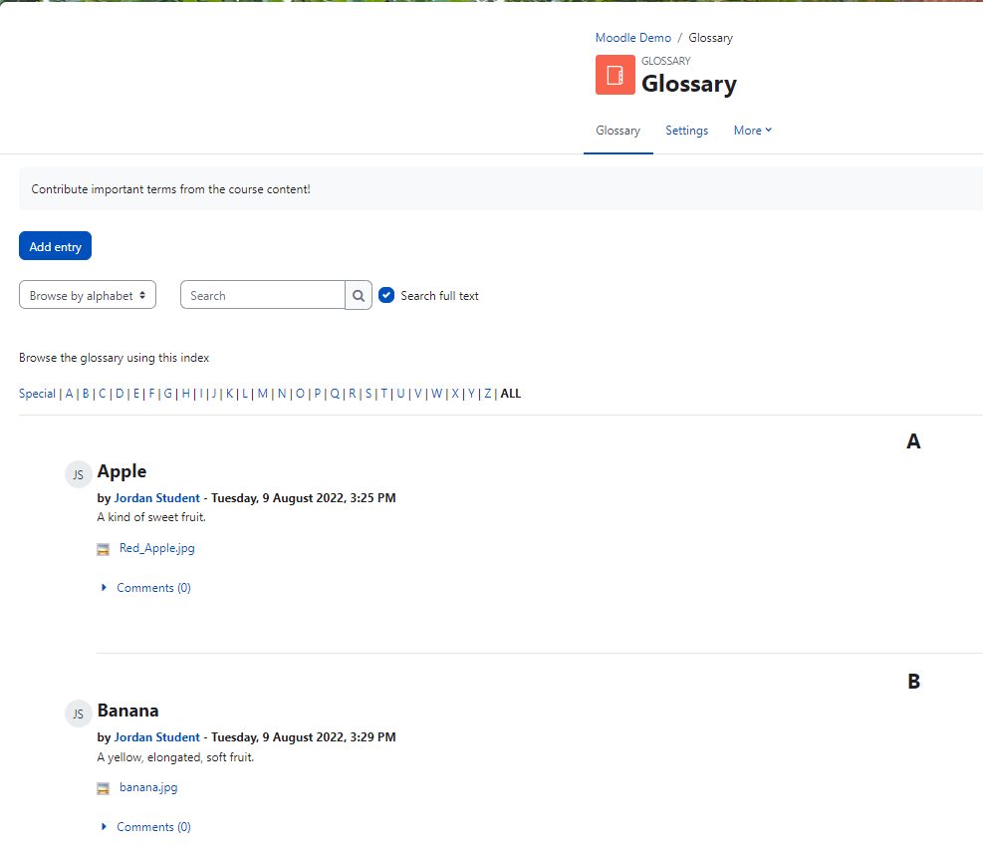
Course Glossary
The glossary tool in Moodle has many functions. Glossaries can be found in many textbooks. However, on Moodle, you can ask students to contribute terms that they come across in their class readings and discussions. Entries can then be made available to the whole class.
You could also assign a few terms (from biology, economics, from the works of Martin Heidegger, etc.) to each student and have them create entries for the benefit of the class.

Slide 10
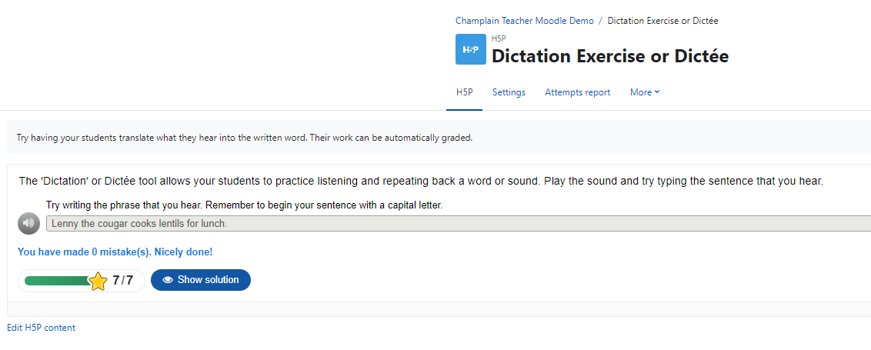
Dictée/Dictation Exercise
Language instructors can record words or short phrases and have students practice transcribing the words.
Automatic grading can be set up according to various parameters. (For example, the strictness with respect to spelling accuracy can be adjusted.)

Slide 11
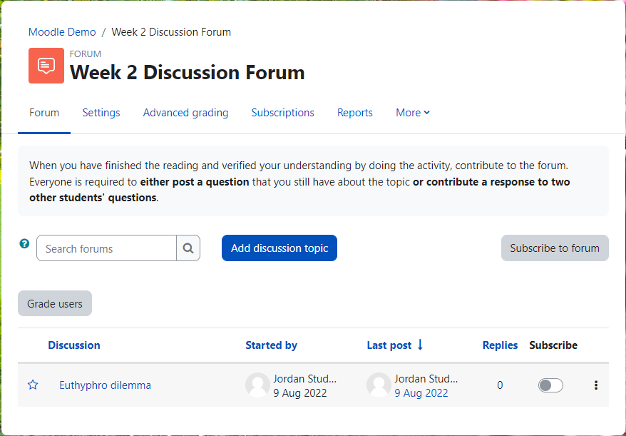
Set Up Forums and Grade Student Contributions
You can set up forums for student discussion. You can also grade forum posts (or choose not to).

Slide 12
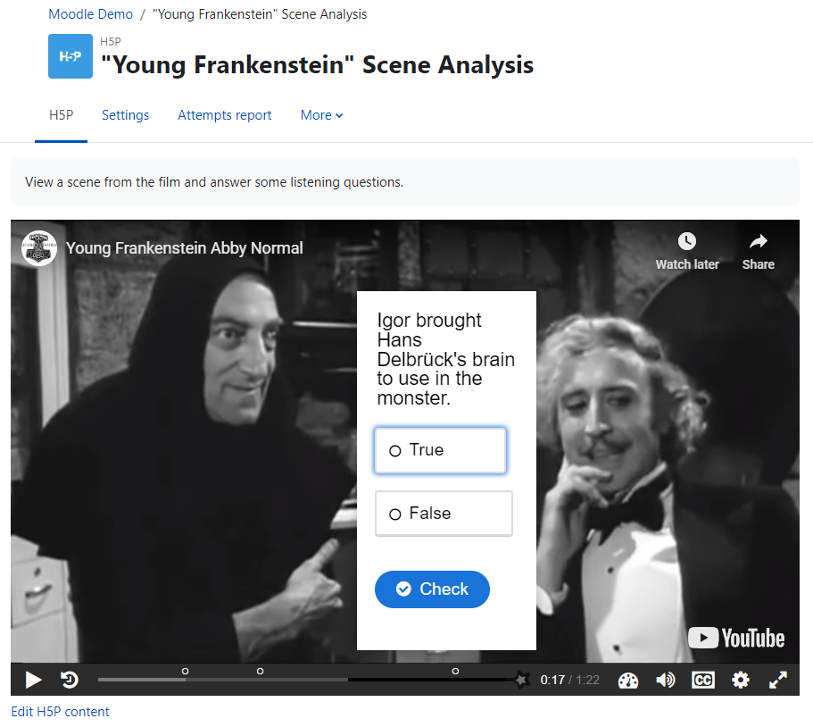
Interactive Videos
Interactive videos can be created and shared with students. Videos can be uploaded or streamed from Youtube and elsewhere; and the instructor can add several kinds of questions that appear to students while they watch.
Parameters can be manipulated so that incorrect answers send the viewer back to an earlier part of the video. Students can also be compelled to answer all the questions correctly before moving onto a subsequent Moodle activity.
Instructors can also make their own lecture videos interactive in this way.

Slide 13
3. How can I Integrate Moodle into my Teaching?
Like any pedagogical method or tool, it takes a little time to learn how to use Moodle and to prepare teaching content to be used with Moodle.
Here are a few things that you can try:

Slide 14
a. Try setting up a Moodle course
By default, Moodle courses are set to be ‘invisible’, so you can experiment with settings and activities without worry.
To find out how to create a new course in Moodle, see the “Basic Moodle Setup and Use (for Teachers)” on the IT help site.

Slide 15
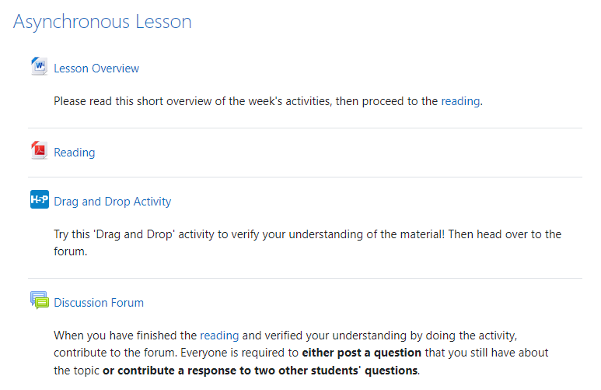
b. Design a single flipped-classroom lesson
You can design a single week’s lesson with a reading, an interactive video, a quiz, a discussion forum, or whatever you like.
If your course schedule is somewhat flexible, you can simply have an asynchronous lesson ready in the event that you unexpectedly need to miss a class.
You can explain to students in advance how to sign into Moodle and join your class, or you can save some simple instructions ready to guide them onto Moodle and through your lesson.
Students can go through the Moodle lesson on their own and be prepared, in the following class, to discuss what they learned.

Slide 16
c. Slowly integrate new features into your repertoire of pedagogical tools
At its most basic, Moodle can be simply used to post documents and links, or to create basic quizzes (for grades or not). You can begin using Moodle’s most basic features for your class and from session to session or year to year, try slowly integrating new tools that interest you.

