Slide 1
Basic Introduction to Moodle Quizzes and the Question Bank
1. Creating a Quiz
2. Adding Quiz Questions
3. The Question Bank and Categories
4. Importing and Exporting Questions
5. Changing Quiz or Assignment Settings for a Single Student
Fall 2022
Updated Fall 2023

Slide 2
1. Creating a Quiz
On your course page, turn on Edit mode in the top, right-hand corner.

Slide 3
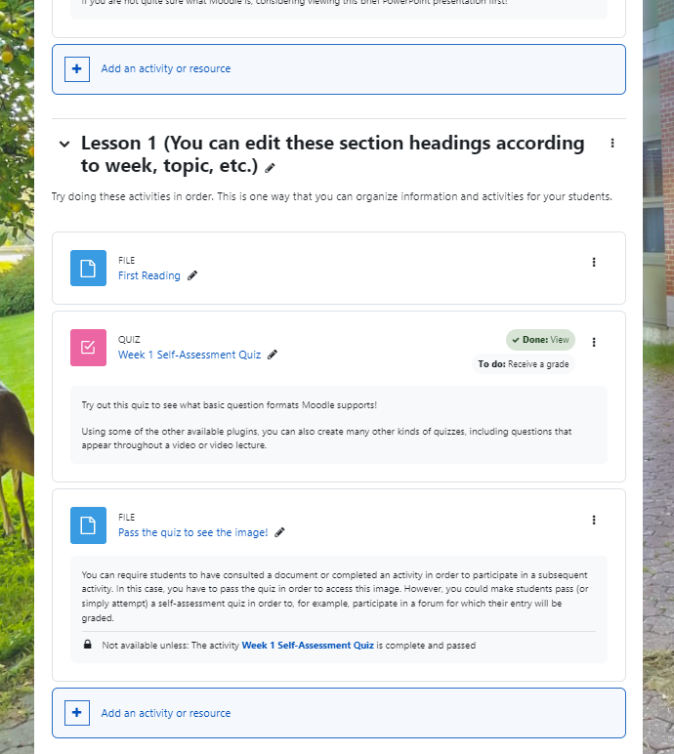
Then select where you want your quiz to appear by clicking on one of the
+ Add an activity or resource icons.
(You can reorder items on your page later on.)

Slide 4
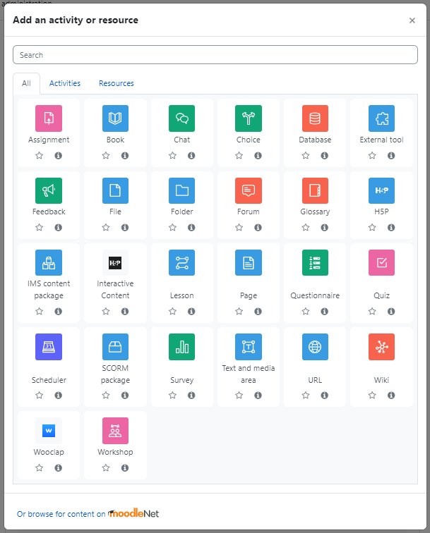
In the window that appears, select the Quiz icon.

Slide 5
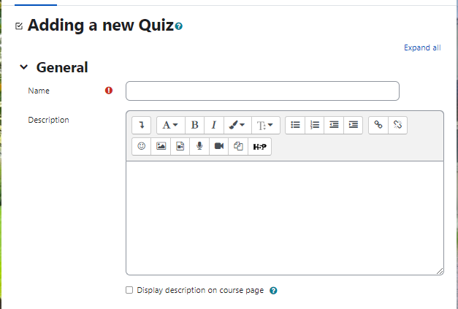
A new window will open. Give your quiz a Name or title.
You can also add a description and choose whether the description will appear on the course page below the quiz.
The description can be informative for students; e.g., “Optional Practice Quiz,” or “Quiz 1 Due September 14 by 6 PM,” etc.

Slide 6
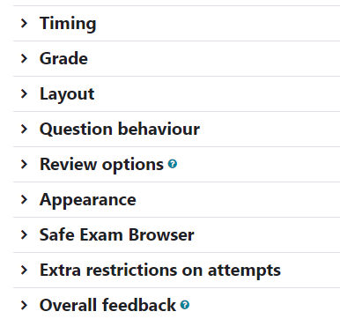
Scroll down.
Click the little arrow heads to see the quiz parameters that can be changed.

Slide 7
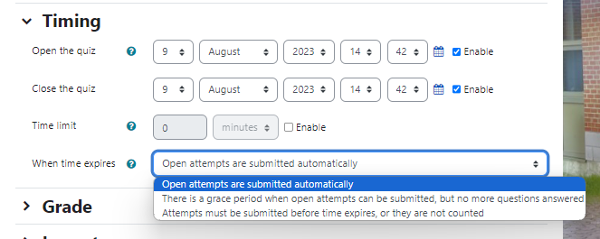
Timing
You can decide when the quiz Opens (i.e., from what date students are able to attempt the quiz) and when it Closes (i.e., when their deadline to write it is). You can also determine how much time a student has to write the quiz once he/she has started it; and you can determine what happens when the permitted time elapses while the student is still writing the quiz.

Slide 8
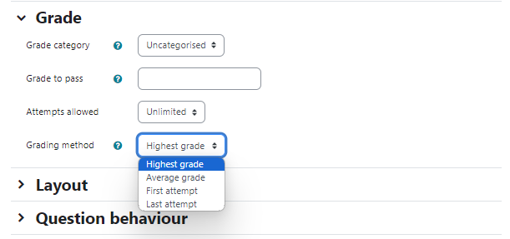
Grade
If you have set up your gradebook and made various Grade Categories, then you can put the quiz into a category. (An example of a category would be ‘Quizzes’ or ‘Short Assignments’. You can move the quiz into a category at a later time by editing the Gradebook Setup.)
You can also determine how many attempts students are allowed and, if multiple attempts are allowed, how the student’s grade for the assignment will be calculated after multiple attempts.

Slide 9
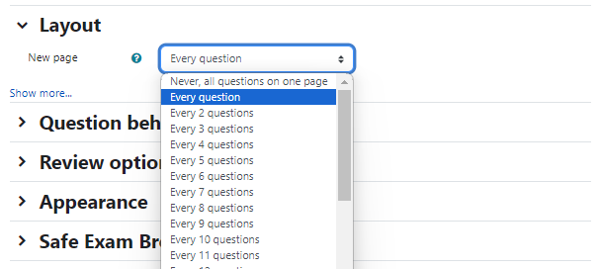
Layout
You can decide how many questions appear on each ‘page’ of the quiz (i.e., how many questions the student can see at once); and you can decide whether students can freely return to previous pages of the quiz before the final submission.
This can also be revised at a later stage.

Slide 10
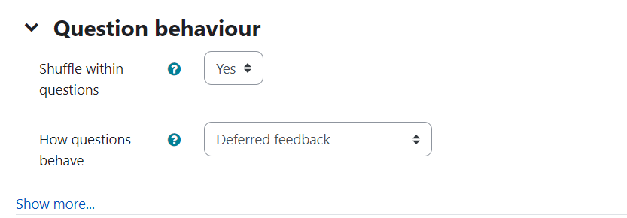
Question Behaviour
There are various options that affect how students interact with the questions. Put your cursor over the question mark icons to see more information.
You can choose for students to all receive questions in the same order, or you can choose for the questions to be shuffled.
You can also determine when students receive feedback. If students have one chance to write the entire quiz, the feedback would usually be deferred until sometime after the student (or after everyone) has submitted the quiz. If students are able to retry a question after selecting an incorrect answer, then the setting can be changed to allow students to see immediately when an answer is incorrect; and students might sometimes be given a hint.

Slide 11
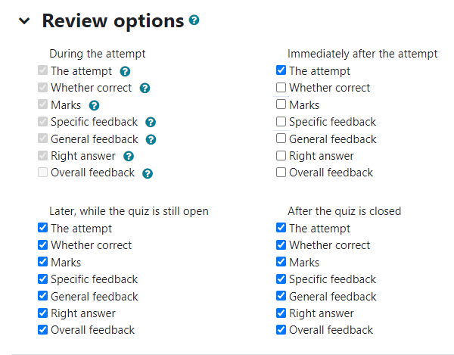
Review Options
The review options affect what kind of feedback students receive and when. You can stipulate what information students receive about their quiz answers (1) during the attempt (i.e., while they are writing the quiz), (2) immediately after the quiz, (3) after the student has written the quiz but while the quiz is still open and available to other students, and (4) after the quiz has closed and can no longer be written by anyone in the class.
These settings can be changed depending on the purpose of the quiz. Are students allowed to collaborate and reattempt answers? Or is the quiz intended to be written individually for a grade? In the latter case, for example, you might prevent students from receiving any feedback until the quiz has closed.
1
2
3
4

Slide 12
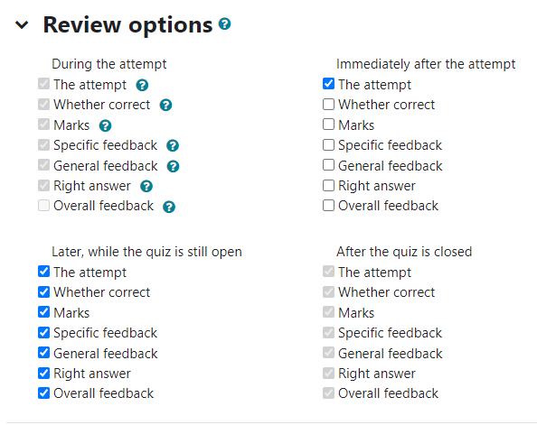
“Some review options are grey and cannot be changed. Why?”
Settings cannot be changed when they do not apply. For example, if in the Question Behaviour section you have set the quiz up so that feedback is deferred, then students cannot receive any feedback while they are attempting the quiz. In that case, Moodle will not let you change the parameters in the first column.
Likewise, if you have not enabled a ‘Close time’ and set a limit for when the quiz can be written (i.e., if the quiz is always available to all students), then the quiz never closes. In that case, the settings in the fourth column will be irrelevant and Moodle will not allow you to change them.

Slide 13
When you have reviewed the other quiz options, click Save and Display at the bottom of the page.
You can always change the parameters by returning to the quiz settings. To do this, click on the quiz (which should now be available on your course page). Then click on the Settings tab.

Slide 14
2. Adding Quiz Questions
Having adjusted your quiz parameters and clicked Save and Display, you should arrive on the quiz page. (You can also access this by going to your course homepage and clicking on the quiz that you have just created.)
Click on the Questions tab to begin adding questions to your quiz.
Note that to change the basic parameters of the quiz (allotted time, feedback settings, grade calculations, etc.), you must navigate to the Settings tab (see the previous slide). But to edit the questions within the quiz, you need to navigate to the Questions tab.

Slide 15
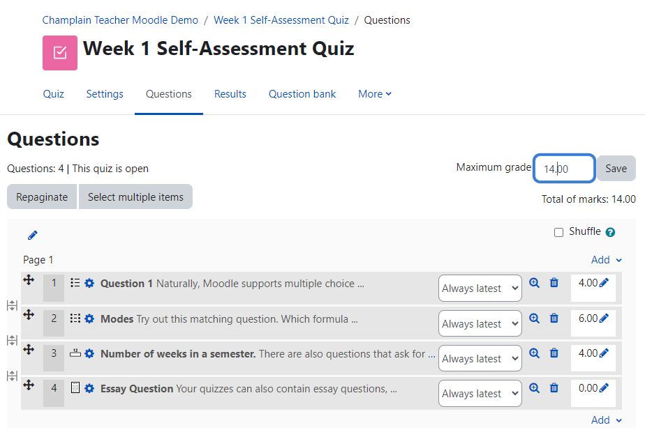
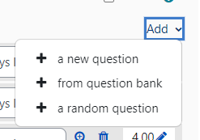
From the Questions tab you can set the maximum grade for the quiz (i.e., how many points the quiz is out of). You can also decide whether the quiz questions (once you have added them) should be shuffled when students receive them.
To begin, click on Add. A drop-down menu will appear. Since we have not yet set up a question bank, we will simply add a new question, which we will now create.

Slide 16
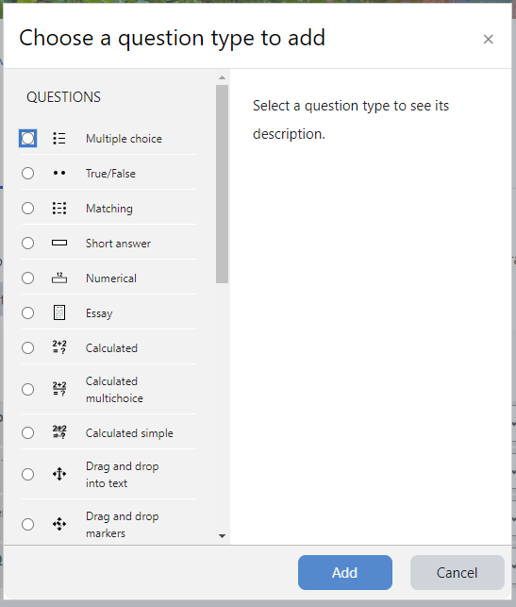
A menu will appear offering many kinds of question formats. You can click on each one to see a brief description.
Multiple choice, True/False, Matching, Short answer, Fill-in-the-blank, Essay (which must be graded manually), and other formats are available.
We will add a Multiple-choice question.

Slide 17
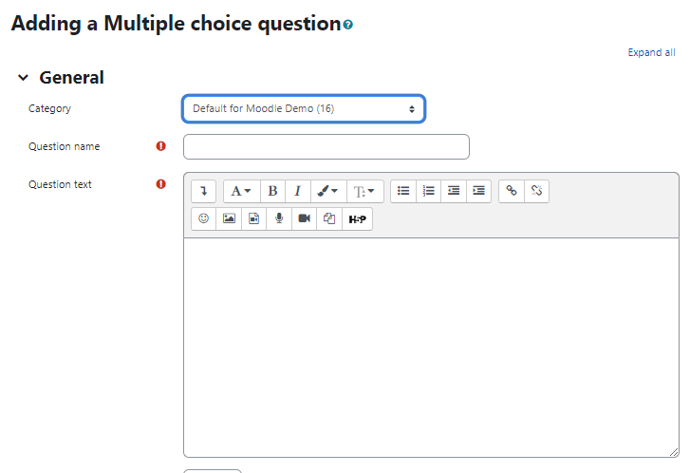
When you create a new question, Moodle will automatically save the question in your Quiz bank.
Your quiz bank is a collection of questions that you have created and which can be reused for other quizzes.
If you have already arranged quiz bank Categories, you can choose in which one you want to place your new question. Otherwise, you can select the default category that Moodle has created for the quiz or for the course.
A quiz bank corresponding to each of your courses will have been created by default.

Slide 18
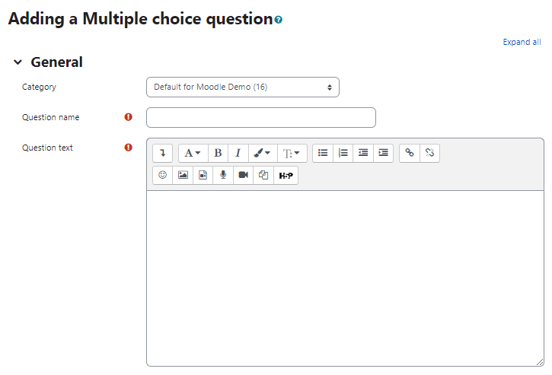
Choosing an informative Question name helps you easily sort through your question bank later on when you need to make a new quiz.
You could call your question “Trigonometry Question 5,” or “Plato’s theory of anamnesis,” or whatever will later help you easily locate the questions you need.

Slide 19
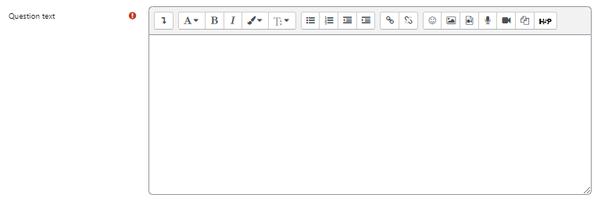
Fill in the question text. This is the question that will actually appear to your students.

Slide 20
You can set the Default mark for the question. Because we are adding this question both to our quiz and to our quiz bank, Moodle is asking how many marks this question should usually be worth. In this case, because it is a multiple choice question, perhaps it should only be worth 1 point. Other kinds of more elaborate questions might be worth more; or sometimes you might want to make all questions worth 2 or 3 points just so that the quiz total comes out to an easily divisible number. Whenever you borrow a question from the quiz bank, you will be able to change how many points it is worth for a given quiz.

Slide 21
In the General feedback section, you can add the feedback that every student will see (at whatever point you have determined in the quiz settings that they should receive the General feedback). You can add images to help memory and retention.
The General feedback can also tell students where to find the pertinent information if they got the question wrong. E.g., “See Lesson 8, Slide 4,” or “See The Fundamentals of Calculus, Ch. 2.”

Slide 22
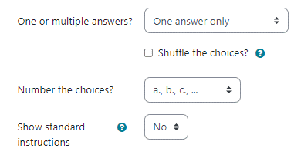
The default setting for this type of question is that only one answer can be chosen by the student. In this case, we will keep the default setting, but there are many possibilities to explore in Moodle.
You have the option to Shuffle the order of the choices that the student receives, and you can choose how the choices are numbered.
Note: If you elect to shuffle the choices, make sure you do not use answers like “All of the above,” “None of the above,” or “A and C.” If the answers are shuffled, then these often will not make sense to the student.

Slide 23
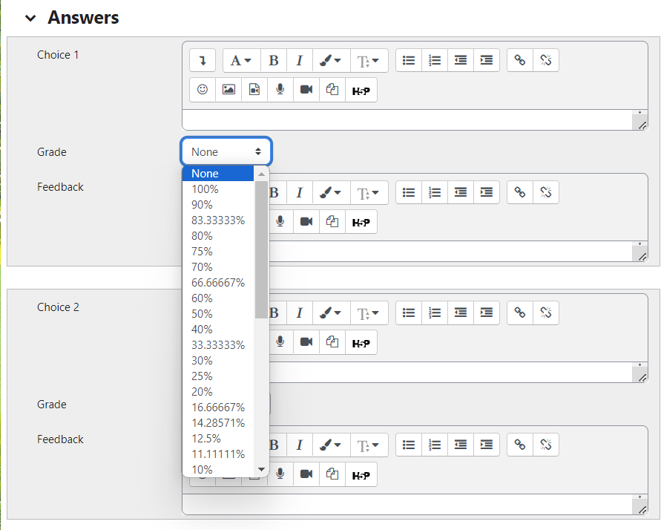
For a multiple-choice question, create a selection of incorrect answers and one correct answer.
You can specify the Grade to be received for each correct and partially correct answer.
At least one of the choices must be worth 100%. You can make another partially correct answer worth, e.g., 50% of the grade.

Slide 24
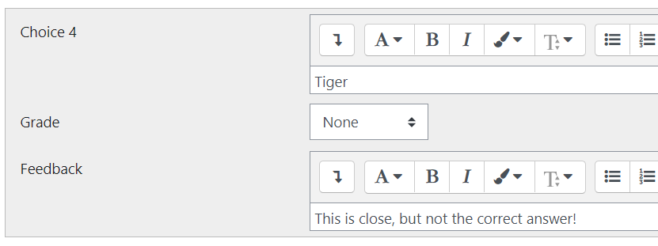
The choice-specific feedback can be useful. You can say things like, “This was indeed discussed in the dialogue, but Socrates rejected this thesis”; or, “This is the incorrect solution you get if you use the Sine function instead of the Cosine function.”

Slide 25
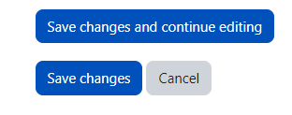
You can explore the other quiz settings, but this should be sufficient to set up a basic multiple-choice question.
When you are finished, select Save Changes at the bottom.

Slide 26
Back on the quiz page, we can see our new quiz question has been added.
I can easily change how many points this question is worth.
Or I can edit the question by clicking on it.
You can also preview the question again by clicking on the magnifying glass.
When you are finished adding questions, you should make sure that the total number of points of the questions should equal the maximum grade that you have designated for the quiz.

Slide 27
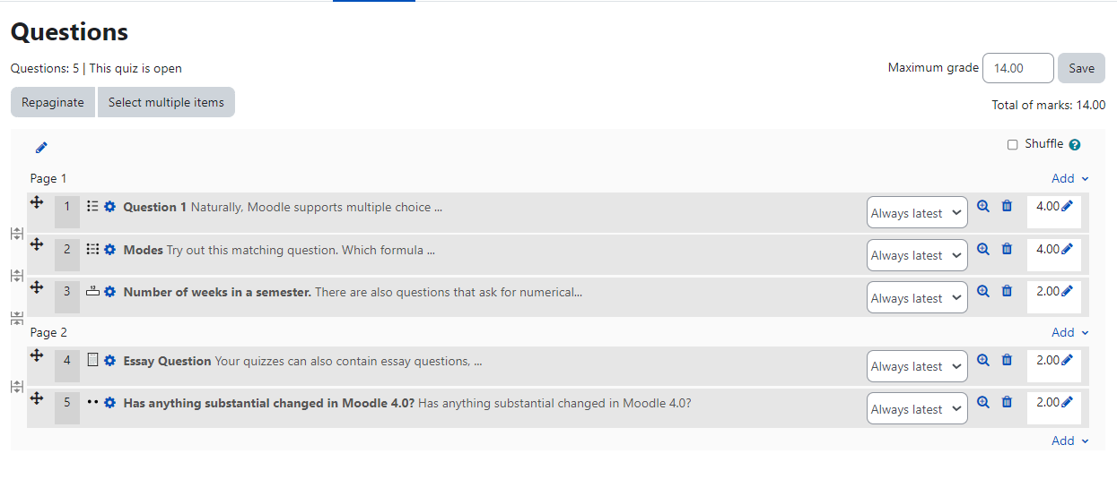
Once you have set up a few questions, you can use the arrow cross to reorder them. You can also Repaginate to change how many questions appear on a given page of the quiz. In this case, there are two pages, one with three questions and the other with two.

Slide 28
When you are finished, you can navigate back to your course page. To review the quiz and question details or to preview the quiz (which you should always do!), click on the quiz name.
From there you can change the quiz Settings, add or edit Questions, or Preview the quiz.

Slide 29
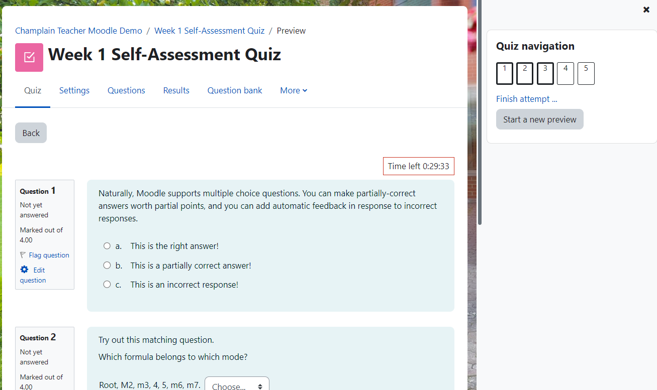
The quiz preview allows you to see and experience the quiz in exactly the way that your students will.

Slide 30
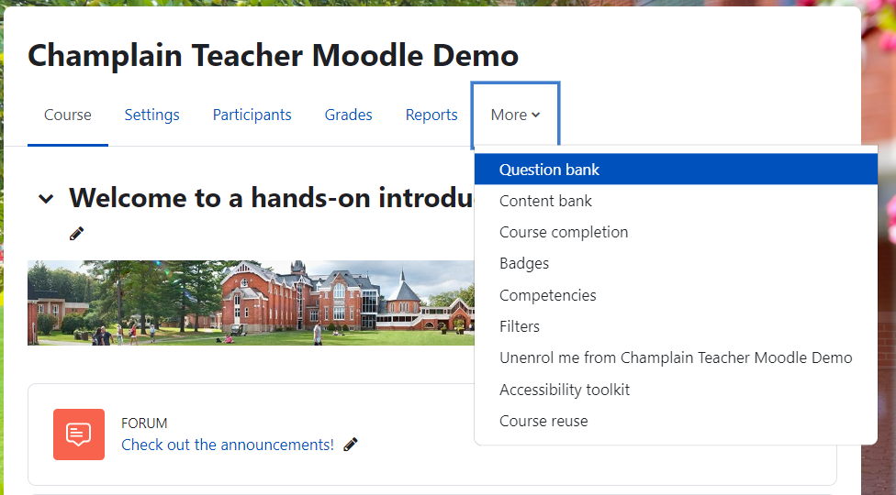
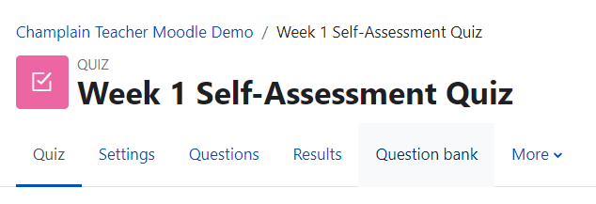
3. The Question Bank and Categories
When you create new questions in a quiz, they are automatically stored in a bank (see slide 17).
On either the course page or a particular quiz page, you can access the Question bank.

Slide 31
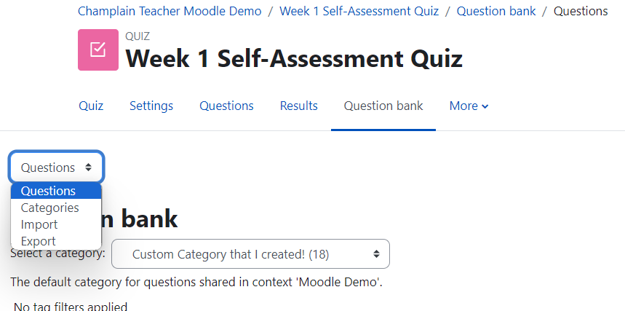
Once you have access a question bank, the menu at the top will allow you to access:
Questions in order to add or edit questions.
Categories in order to add or edit categories.
Import in order to import questions from a file.
Export in order to export a bank of questions.

Slide 32
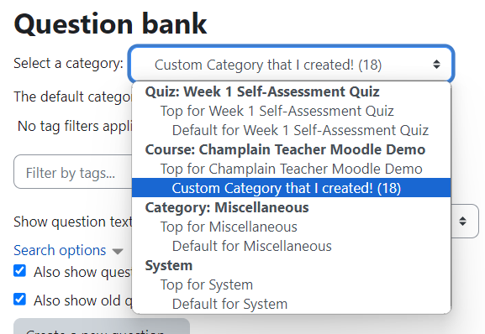
Within the Questions section, select a bank Category to view or alter.
This menu looks slightly different depending on whether you have accessed the bank from the course or from a particular quiz.
If you access it from a particular quiz, then it will allow you to see the specific bank category for that quiz, as well as the broader bank category for that course.

Slide 33
Looking at the list of questions in a quiz bank category, you have various question display options, and various kinds of information about each question is shown.
Among the information here, one can see each question’s facility index (i.e., how often students get the question right); its discriminative efficiency (i.e., how well it seems to indicate a student’s relevant knowledge or abilities)*; its usage, or how many quizzes are using the question.
*The discriminative efficiency represents the question’s ability to distinguish between different levels of student achievement. For example, if students are all getting a given question right, or all of them are getting the question wrong, then the question has little ability to indicate how well the students are doing relative to one another and is unlikely to be a useful gauge for the instructor. Read more here.

Slide 34
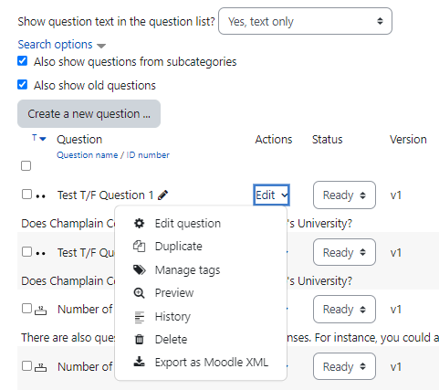
From this same page, you can also Create a new question, as well as Edit, Delete, or Preview an existing question (among other tasks).

Slide 35
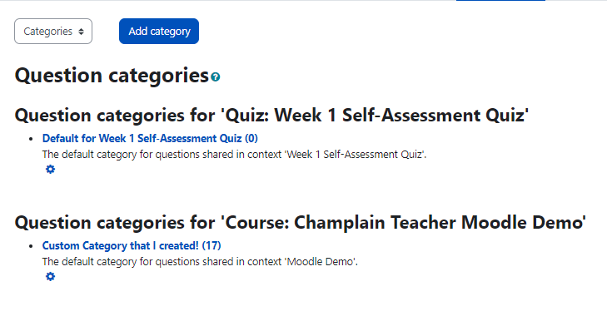
By switching to the category view, you can see and rename any subcategories within the question banks for your course and for a particular quiz.
You can also add subcategories. (This may be useful if you want to have banks of questions categorized by topic.)

Slide 36
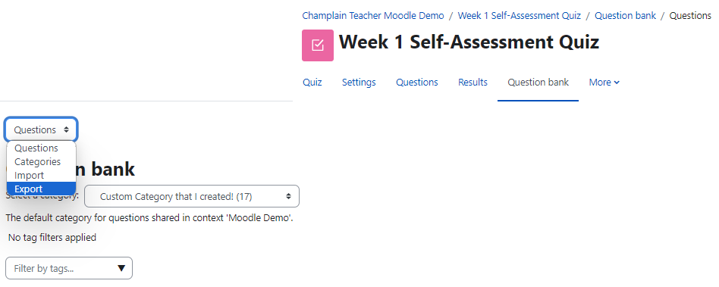
4. Importing and Exporting Questions
In Moodle, you can import questions from, and export questions to, various kinds of document formats.
From the Question bank tab in your quiz, select Export or Import from the menu.

Slide 37
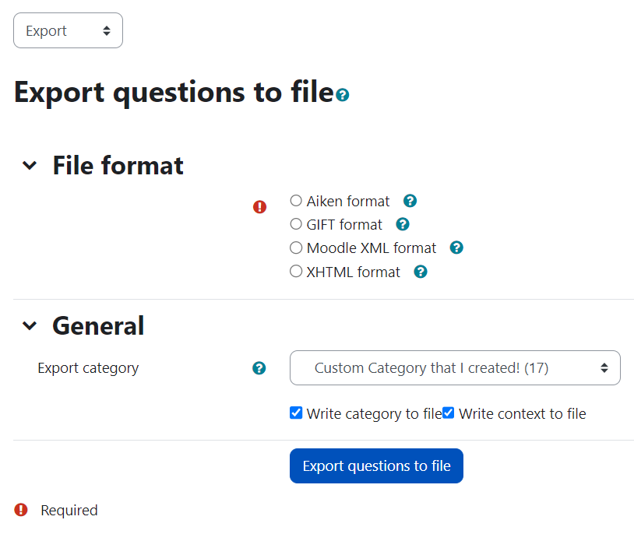
In the Export section, you can elect to export questions from your Question bank in various formats; and in the Import tab, you can elect to import questions from a file.
These features might be useful if you are using multiple platforms, sharing quiz questions with colleagues, or if you use Moodle at multiple institutions. Note: Not all format types support all types of quiz questions. Review your specific needs and compatibilities.
The Aiken format can simply export some types of questions to a text file. The Moodle XML format is good for exporting questions to later be used again in Moodle. You can get additional information about the File formats by putting your cursor over the question mark icons .
Additional information can be found here.

Slide 38
5. Changing Quiz or Assignment Settings for a Single Student
Sometimes a single student needs more flexibility in terms of when they write the quiz, or sometimes special accommodations will require that a student be given more time.
In Moodle, you can ‘override’ the quiz settings for a single student.

Slide 39
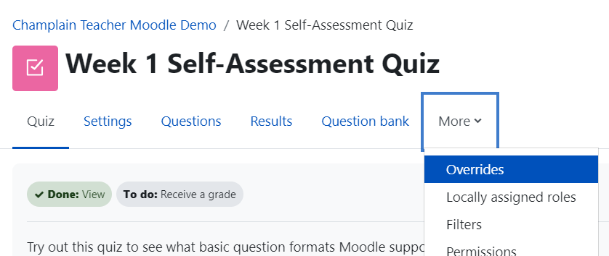
Go to your quiz page, select the More tab, and then select Overrides.
To add special parameters for an individual student, select Add user override on the new page.

Slide 40
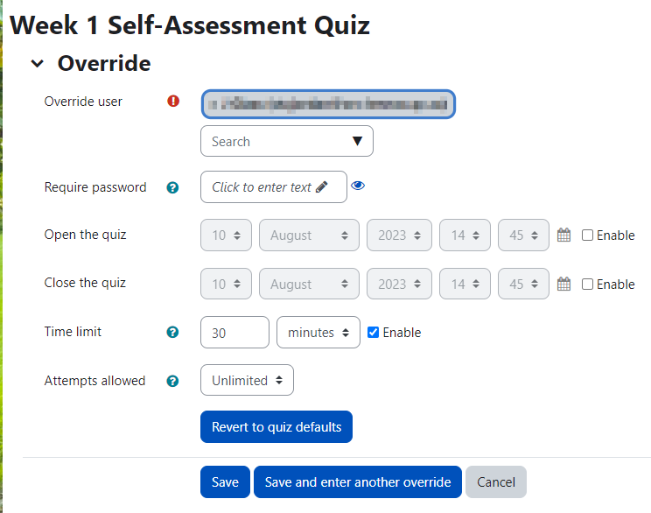
Search for the student in question by typing the student’s name or using the drop-down menu.
From here you can change when the quiz becomes available to the student, when it will no longer be available, as well as how much time the student has to complete the quiz once he/she has begun.
You can also change how many attempts a student is allowed.

